Slide 1
Mapping ER Model to Relational Model
Sumber: Silberschatz, Korth and Sudarshan, Database System Concepts, 6th Ed.
Jeffrey A. Hoffer, Mary B. Prescott, Fred R. McFadden, Modern Database Management, 8th Ed.
Program Studi Teknik Informatika
Institut Teknologi Bandung

Slide 2
Learning Outcomes
Prepare a relational schema from a conceptual model developed using the entity- relationship model
Explain and demonstrate the concepts of entity integrity constraint and referential integrity constraint (including definition of the concept of a foreign key)

Slide 3
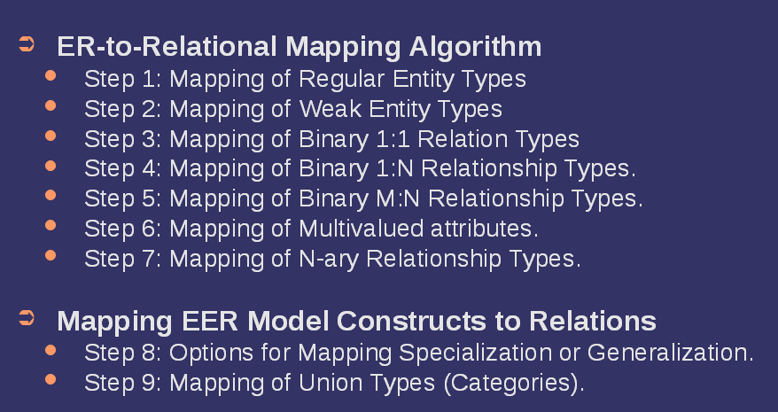
Type of Mapping from ER to Relational Model

Slide 4
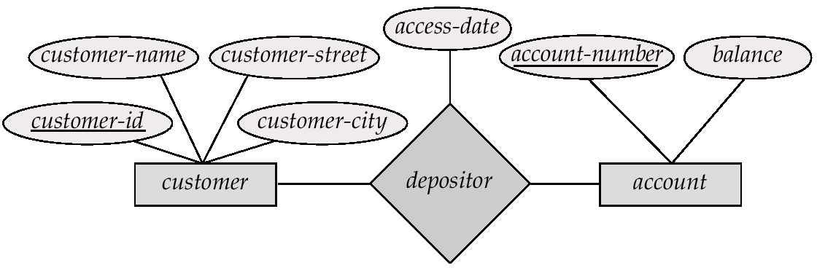
Entity-Relationship Model
Example of schema in the entity-relationship model

Slide 5
Relational Model
Example of tabular data in the relational model
Attributes
tuples
Customer-id
customer-
name
customer-
street
customer-
city
account-
number
192-83-7465
019-28-3746
192-83-7465
321-12-3123
019-28-3746
Johnson
Smith
Johnson
Jones
Smith
Alma
North
Alma
Main
North
Palo Alto
Rye
Palo Alto
Harrison
Rye
A-101
A-215
A-201
A-217
A-201

Slide 6
Correspondence of Relational Model with E-R Model
Relations (tables) correspond with entity types and with many-to-many relationship types
Rows correspond with entity instances and with many-to-many relationship instances
Columns correspond with attributes
NOTE: The word relation (in relational database) is NOT the same as the word relationship (in E-R model)

Slide 7
Reduction ER Model to Relation Schemas
Entity sets and relationship sets can be expressed uniformly as relation schemas that represent the contents of the database.
A database which conforms to an ER diagram can be represented by a collection of schemas.
For each entity set and relationship set there is a unique schema that is assigned the name of the corresponding entity set or relationship set.
Each schema has a number of columns (generally corresponding to attributes), which have unique names.

Slide 8
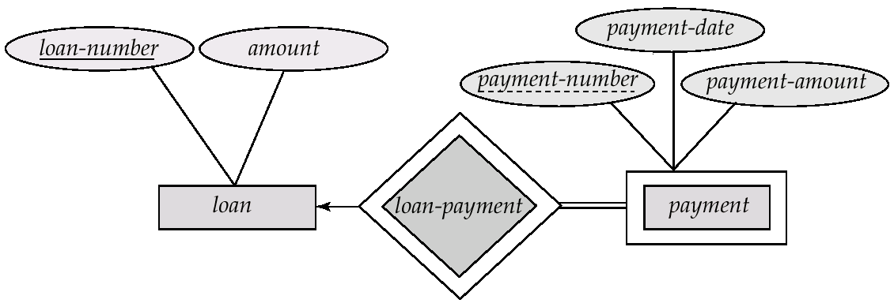
Representing Entity Sets With Simple Attributes
A strong entity set reduces to a schema with the same attributes LOAN = (LOAN_NUMBER, AMOUNT)
A weak entity set becomes a relation that includes an attribute for the primary key of the identifying strong entity set
Primary key composed of:
Discriminator of weak entity
Primary key of identifying relation (strong entity)
PAYMENT = ( LOAN_NUMBER, PAYMENT_NUMBER, PAYMENT_DATE, PAYMENT_AMOUNT )

Slide 9
Example – Strong Entity Set
SID
Name
SSN
Name
Student
Advisor
Professor
Major
Dept
GPA
SID | Name | Major | GPA
1234 | John | CS | 2.8
5678 | Mary | EE | 3.6
SSN | Name | Dept
9999 | Smith | Math
8888 | Lee | CS

Slide 10
Example – Weak Entity Set
Age
SID
Name
Name
Student
owns
Children
Major
GPA
Age | Name | Parent_SID
10 | Bart | 1234
8 | Lisa | 5678
* Primary key of Children is Parent_SID + Name

Slide 11

Representing Relationship Sets
A many-to-many relationship set is represented as a schema with attributes for the primary keys of the two participating entity sets, and any descriptive attributes of the relationship set.
Example: schema for relationship set depositor
DEPOSITOR = (CUSTOMER_ID, ACCOUNT_NUMBER, ACCESS_DATE)

Slide 12
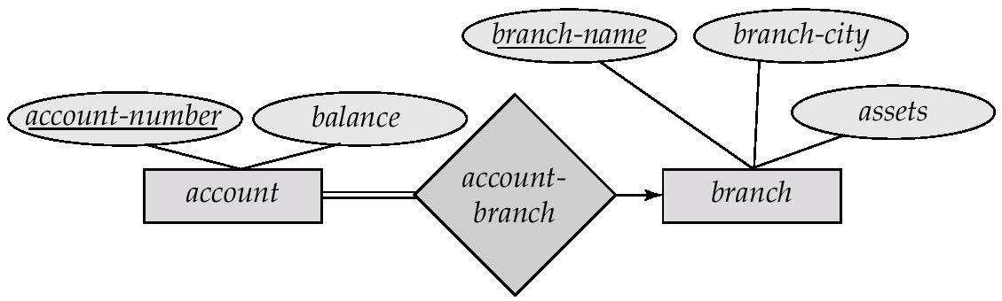
Representing Relationship Sets Redundancy of Schemas
Many-to-one and one-to-many relationship sets that are total on the many-side can be represented by adding an extra attribute to the “many” side, containing the primary key of the “one” side
Example: Instead of creating a schema for relationship set account-branch, add an attribute BRANCH_NAME to the schema arising from entity set account
ACCOUNT = (ACCOUNT_NUMBER, BALANCE, BRANCH_NAME)

Slide 13
Example – Many-to-One Relationship Set
Semester
SID
Name
N:1 Relationship
SSN
Student
Advisor
Professor
Major
GPA
Dept
Name
SID | Name | Major | GPA | Pro_SSN | Ad_Sem
9999 | Bart | Economy | -4.0 | 123-456 | Fall 2006
8888 | Lisa | Physics | 4.0 | 567-890 | Fall 2005
* Primary key of this table is SID

Slide 14
Representing Relationship Sets Redundancy of Schemas (Cont.)
For one-to-one relationship sets, either side can be chosen to act as the “many” side
That is, extra attribute can be added to either of the tables corresponding to the two entity sets
If participation is partial on the “many” side, replacing a relationship by an extra attribute in the schema corresponding to the “many” side could result in null values
Better to avoid it
The schema corresponding to a relationship set linking a weak entity set to its identifying strong entity set is redundant.
Example: The payment schema already contains the attributes that would appear in the loan-payment schema
Notes:
14

Slide 15
Example – One-to-One Relationship Set
Degree
SID
Name
ID Code
Student
study
Major
Major
GPA
SID | Maj_ID Co | S_Degree
9999 | 07 | 1234
8888 | 05 | 5678
* Primary key can be either SID or Maj_ID_Co

Slide 16
Example – One-to-One Relationship Set
Condition
SID
Name
1:1 Relationship
S/N #
Student
Have
Laptop
Major
GPA
Brand
SID | Name | Major | GPA | LP_S/N | Hav_Cond
9999 | Bart | Economy | -4.0 | 123-456 | Own
8888 | Lisa | Physics | 4.0 | 567-890 | Loan
* Primary key can be either SID or LP_S/N

Slide 17
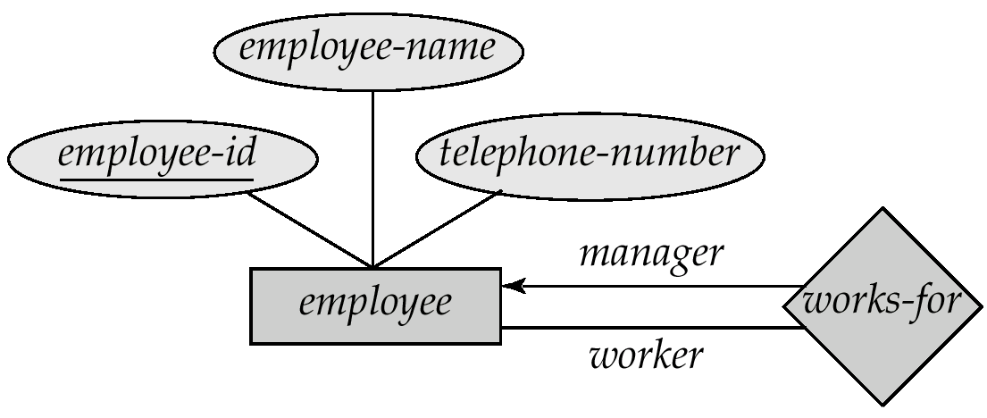
Representing Unary Relationship
One-to-Many: Recursive foreign key in the same relation
EMPLOYEE = (EMP_ID, EMP_NAME, TELEPHONE, MGR_ID)
MGR_ID is the recursive foreign key that refers to primary key of EMPLOYEE (EMP_ID)

Slide 18

Representing Unary Relationship (Cont.)
Many-to-Many: Two relations
One for the entity set
One for the relationship in which the primary key has two attributes, both taken from the primary key of the entity set
ITEM = (ITEM_NO, DESCRIPTION, UNIT_COST)
COMPONENTS = (ITEM_NO, COMPONENT_NO, QUANTITY)
ITEM_NO and COMPONENT_NO are both foreign keys that refer to primary key of ITEM (ITEM_NO)

Slide 19
Representing Ternary (and n-ary) Relationships
One relation for each entity set and one for the relationship set
The relation from the relationship set has foreign keys to each entity set in the relationship set

Slide 20
Example – N-ary Relationship Set
P-Key1
D-Attribute
A-Key
E-Set 1
P-Key2
A relationship
Another Set
E-Set 2
P-Key3
E-Set 3
P-Key1 | P-Key2 | P-Key3 | A-Key | D-Attribute
9999 | 8888 | 7777 | 6666 | Yes
1234 | 5678 | 9012 | 3456 | No
* Primary key of this table is P-Key1 + P-Key2 + P-Key3

Slide 21
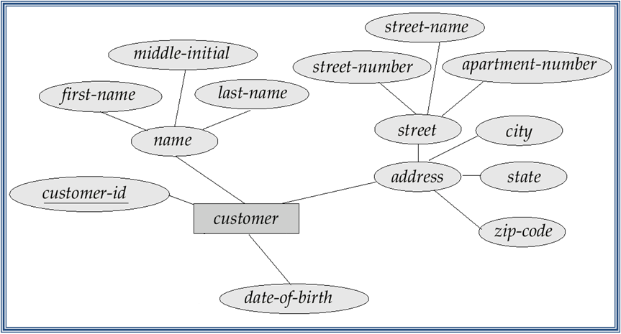
Composite Attributes
Composite attributes are flattened out by creating a separate attribute for each component attribute
Example: given entity set customer with composite attribute name with component attributes first_name, middle_initial, and last_name the schema corresponding to the entity set has three attributes name_first_name, name.middle_initial, and name_last_name
Prefix can be omitted if there is no ambiguity
Ignoring multivalued attributes, extended customer schema is
CUSTOMER = (CUST_ID, FIRST_NAME, MIDDLE_INITIAL, LAST_NAME, STREET_NUMBER, STREET_NAME, APT_NUMBER, CITY, STATE, ZIP_CODE, DOB)
Notes:
21

Slide 22
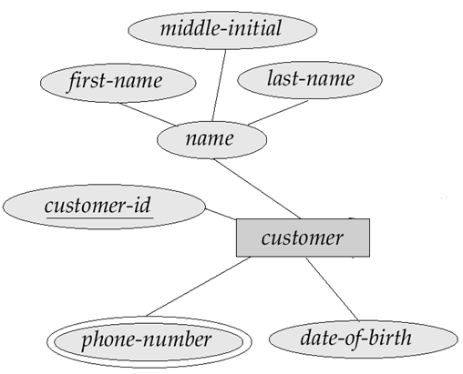
Multivalued Attributes
A multivalued attribute M of an entity E is represented by a separate schema EM
Schema EM has attributes corresponding to the primary key of E and an attribute corresponding to multivalued attribute M
Each value of the multivalued attribute maps to a separate tuple of the relation on schema EM
Example: Multivalued attribute phone_number of customer is represented by a schema:
CUST_PHONE= ( CUST_ID, PHONE_NUMBER )
A customer entity with primary key 22222 and phone numbers 456-7890 and 123-4567 maps to two tuples: (22222, 456-7890) and (22222, 123-4567)
Notes:
22

Slide 23
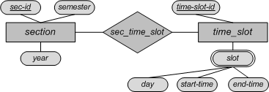
Multivalued Attributes – Special Case
Entity time_slot has only one attribute other than the primary-key attribute, and that attribute is multivalued
Optimization: No need to create the relation corresponding to the entity, just create the one corresponding to the multivalued attribute
TIME_SLOT = (TIME_SLOT_ID, DAY, START_TIME, END_TIME)
Caveat: time_slot attribute of section (from sec_time_slot) cannot be a foreign key due to this optimization. Why?
Notes:
23

Slide 24
Example – Multivalue attribute
SID
Name
The primary key for this table is Student_SID + Children, the union of all attributes
Children
Student
Major
GPA
Stud_SID | Children
1234 | Johnson
1234 | Mary
5678 | Bart
5678 | Lisa
5678 | Maggie
SID | Name | Major | GPA
1234 | John | CS | 2.8
5678 | Homer | EE | 3.6

Slide 25
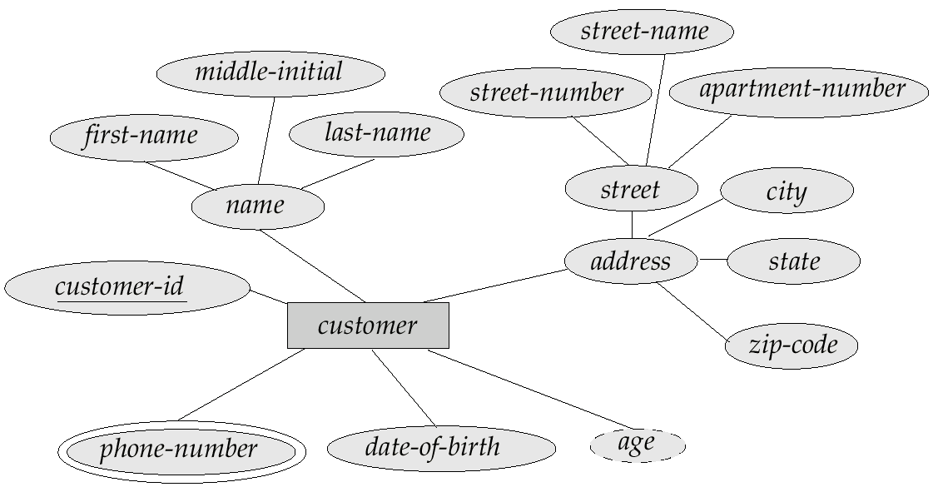
Derived Attributes
Derived attributes are omitted, they are not implemented in the relational schema
Derived attributes are presented using views → more on this later
CUSTOMER = (CUST_ID, FIRST_NAME, MIDDLE_INITIAL, LAST_NAME, STREET_NUMBER, STREET_NAME, APT_NUMBER, CITY, STATE, ZIP_CODE, DOB)
CUST_PHONE= ( CUST_ID, PHONE_NUMBER )
→ AGE is omitted

Slide 26
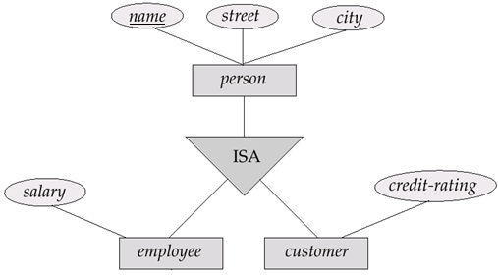
Representing Specialization
Method 1:
Form a schema for the higher-level entity
Form a schema for each lower-level entity set, include primary key of higher-level entity set and local attributes
PERSON = (NAME, STREET, CITY)
EMPLOYEE = (NAME, SALARY)
CUSTOMER = (NAME, CREDIT_RATING)
Drawback: getting information about an employee requires accessing two relations, the one corresponding to the low-level schema and the one corresponding to the high-level schema

Slide 27
Representing Specialization
Method 2:
Form a schema for each entity set with all local and inherited attributes
If specialization is total, the schema for the generalized entity set not required to store information
Can be defined as a “view” relation containing union of specialization relations
But explicit schema may still be needed for foreign key constraints
PERSON = (NAME, STREET, CITY)
EMPLOYEE = (NAME, STREET, CITY, SALARY)
CUSTOMER = (NAME, STREET, CITY, CREDIT_RATING)
Drawback: street and city may be stored redundantly for people who are both employee and customer

Slide 28
Example
SSN
Name
Person
SID
Status
ISA
Gender
Student
Major
GPA
SSN | Name | Gender
1234 | Homer | Male
5678 | Marge | Female
SSN | SID | Status | Major | GPA
1234 | 9999 | Full | CS | 2.8
5678 | 8888 | Part | EE | 3.6

Slide 29
Example
SSN
Name
No table created for superclass entity set
SJSU people
ISA
Disjoint
SID
Student
Faculty
Major
GPA
Dept
SSN | Name | SID | Major | GPA
1234 | John | 9999 | CS | 2.8
5678 | Mary | 8888 | EE | 3.6
SSN | Name | Dept
1234 | John | C.S.
5678 | Mary | Math

Slide 30
Schemas Corresponding to Aggregation
To represent aggregation, create a schema containing
primary key of the aggregated relationship,
the primary key of the associated entity set
any descriptive attributes

Slide 31
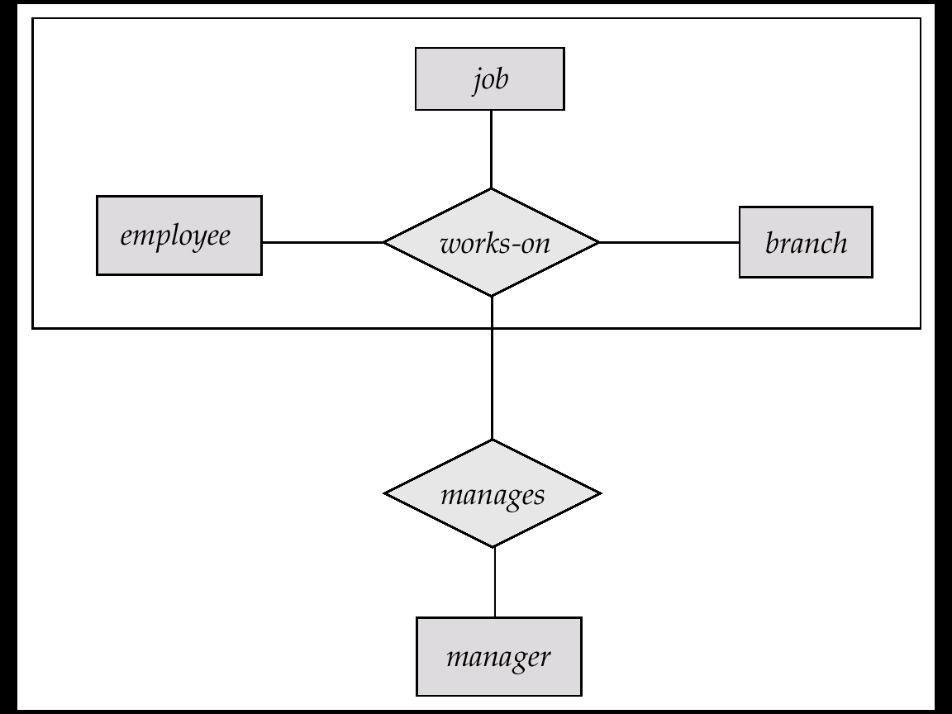
Schemas Corresponding to Aggregation (Cont.)
For example, to represent aggregation manages between relationship works_on and entity set manager, create a schema
MANAGES = (EMP_ID, BRANCH_NAME, TITLE, MGR_NAME)
Schema WORKS_ON is redundant provided we are willing to store null values for attribute MGR_NAME in relation on schema manages

Slide 32
Representing Aggregation
Name
SSN
Name
Student
Advisor
Professor
Dept
SID
Name
Primary Key of Advisor
member
Dept
SID | Code
1234 | 04
5678 | 08
Primary key of Dept
Code

Slide 33
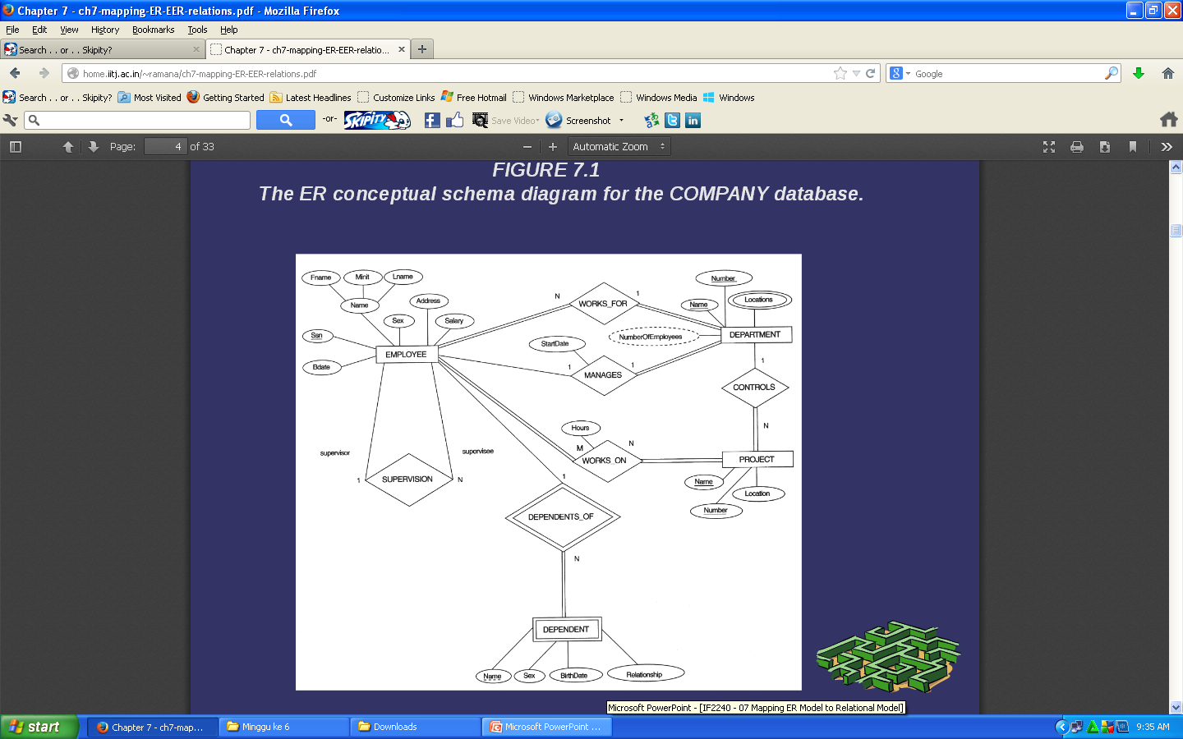
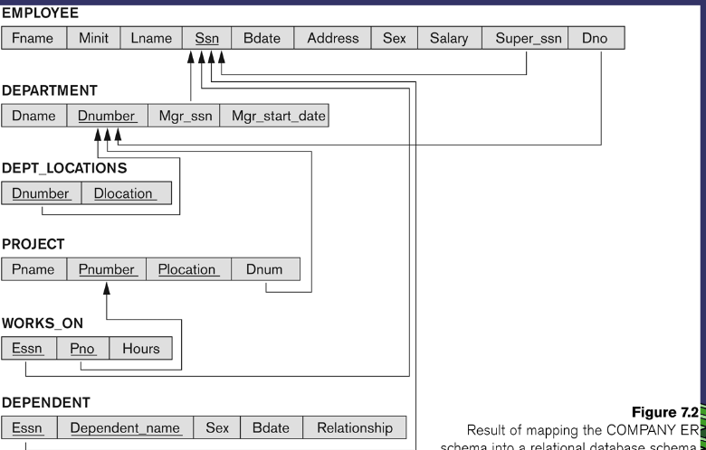
ER Conceptual Diagram for a Company

Slide 34
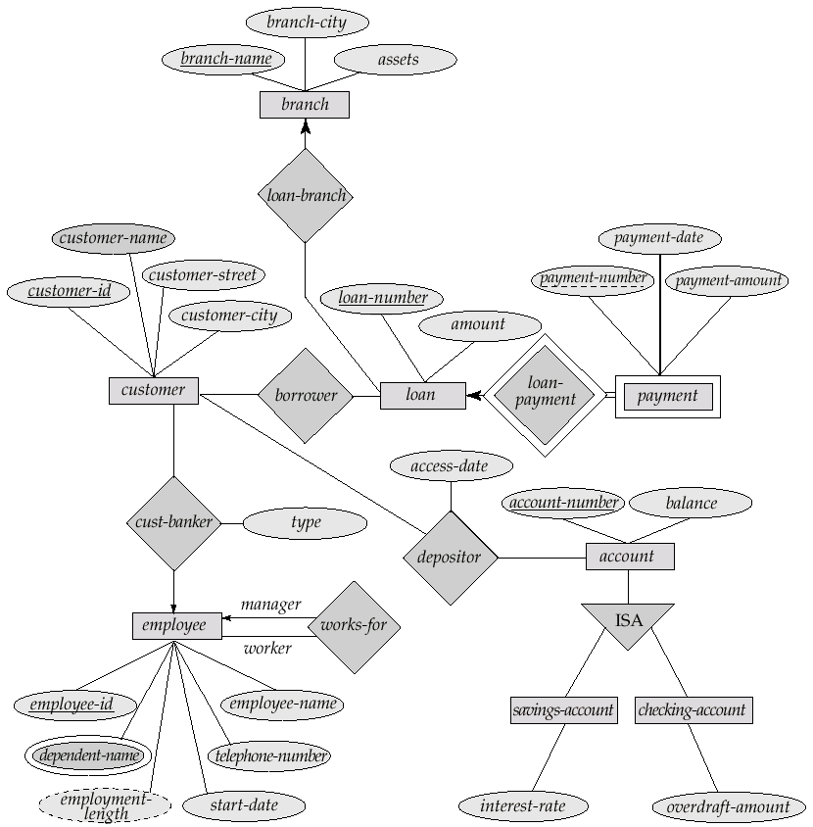
ER Diagram for a Banking Enterprise
Exercise:
Provide the Relational Schema of this ER Diagram for a Banking Enterprise.
Assumption: total participations in all of relationships
Notes:
customer = (customer-id, costomer-name, customer-street, customer-city, banker, banker_type)
branch = (branch-name, branch-city, assets)
loan = (loan-number, amount, branch-name)
payment = (loan-number, payment-number, payment-date, payment-amount)
employee = (employee-id, employee-name, telephone-number, start-date, manager)
employee-dependent = (employee-id, dependent-name)
account = (account-number, balance)
savings-account = (account-number, interest-rate)
checking-account = (account-number, overdraft-amount)
borrower = (customer-id, loan-number)
depositor = (customer-id, account-number, access-date)

